Slide 1
Hotel Booking System
develop by
Henry & Changmin Zhao

Slide 2
The use of Hotel systems has increased drastically since the rise of Web technology started.
With distributed software the customer can choose to self-install or to have the system installed by the vendor on their own hardware.
The customer can be responsible for the operation and maintenance of the application and the data by web site.

Slide 3
solution
Login system
User Register
User Login and validation
Forgot Password retrieve by email by send blue
Login with Gmail authentication

Slide 4
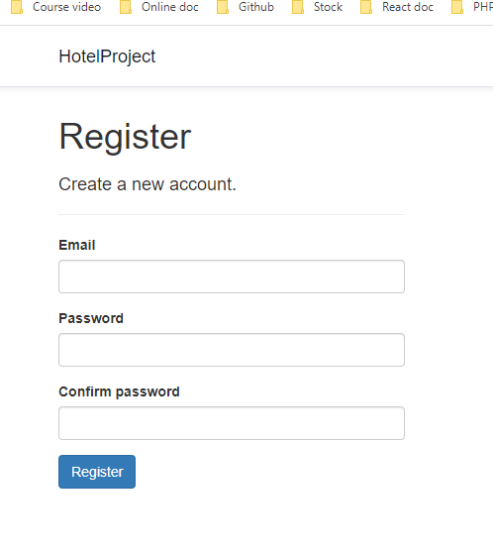
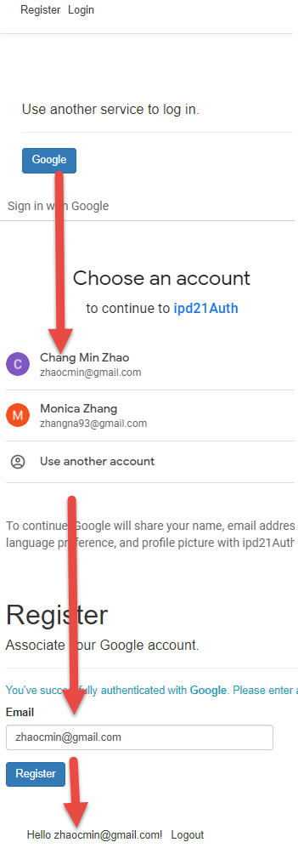
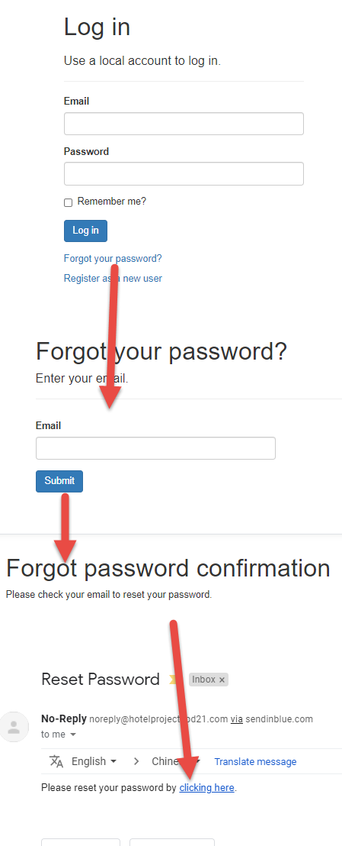
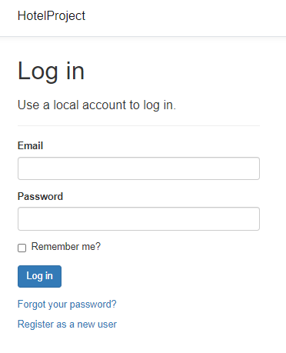

Slide 5
Personal page
User can use their Personal page to check their Account.
Personal Information update.
Stripe Payment.
Personal bills information.

Slide 6

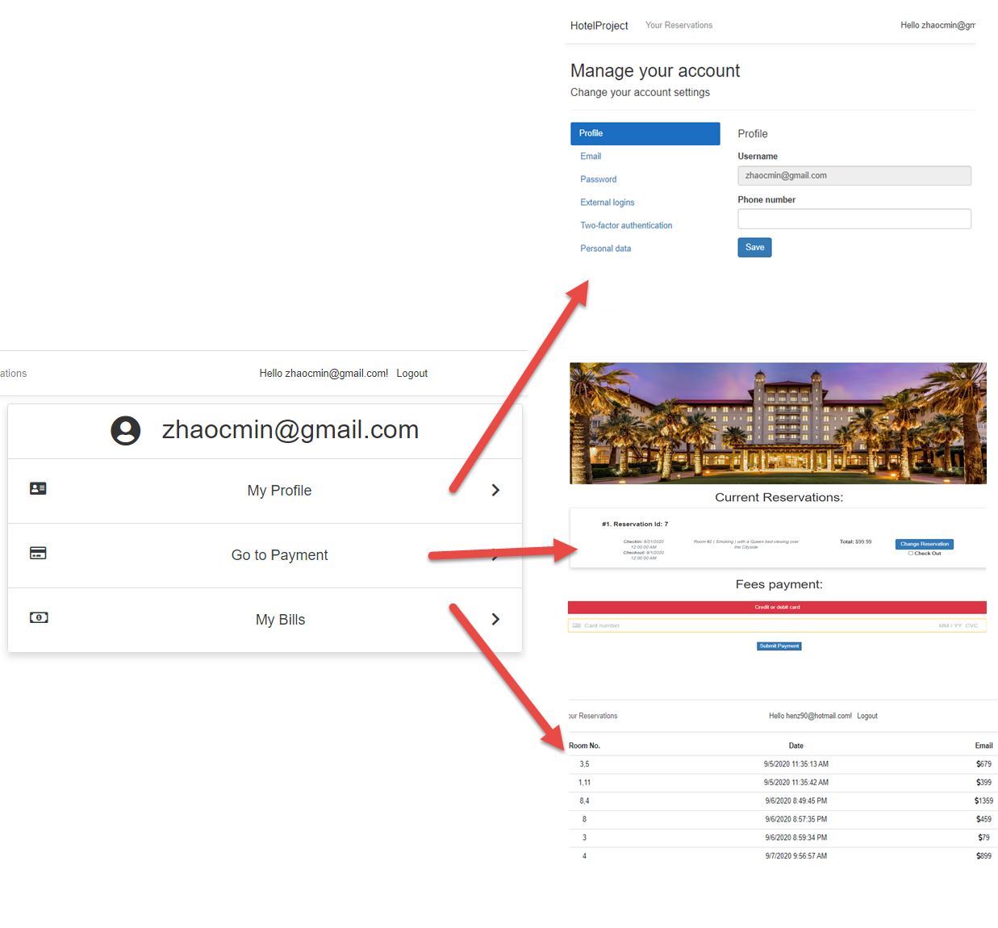
Personal page

Slide 7
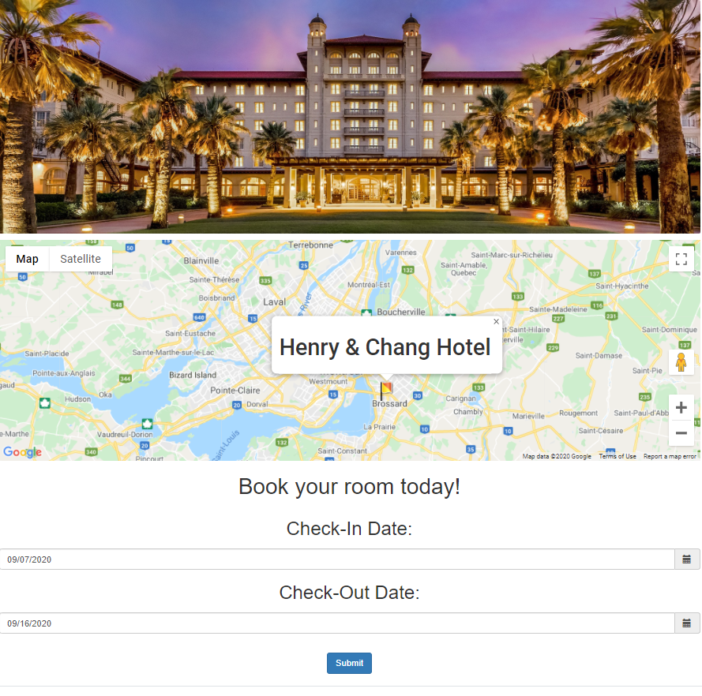
Login successful page

Slide 8
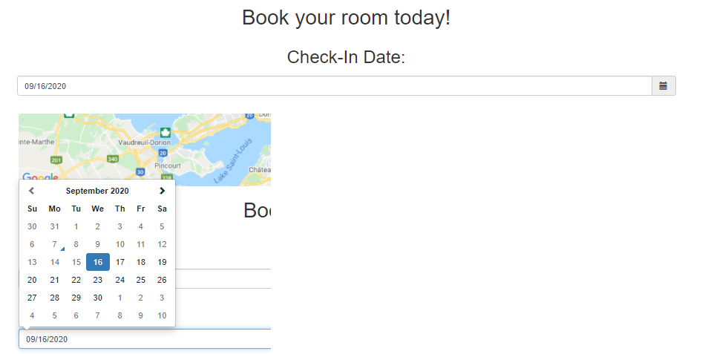
Hotel Reservation system
User can book rooms in the system by select date.
The Date before today Is not allow to select
Checkout date is not allowed to select before the check-in date

Slide 9
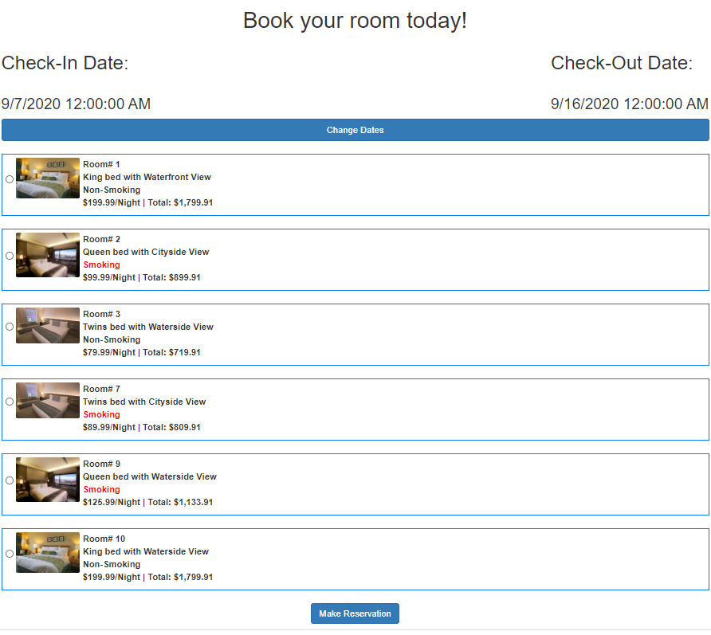
Hotel List
Hotel list will be showing with calculate price base on the duration.
User can only select one time each time.

Slide 10
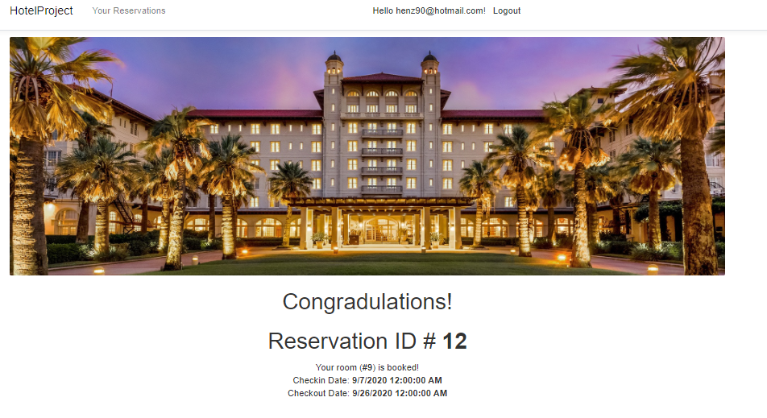

Slide 11
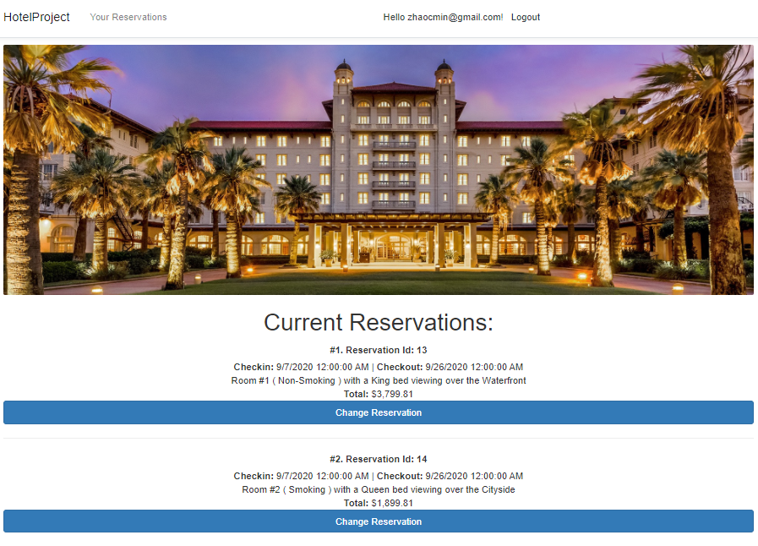
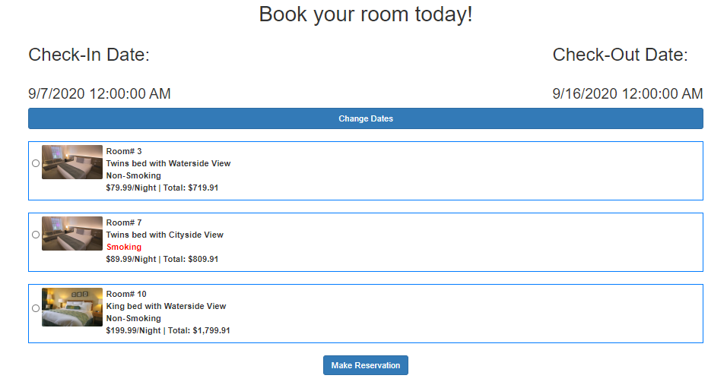
Personal reservation List
After select the rooms by any user, the room will disappear in the Room List

Slide 12
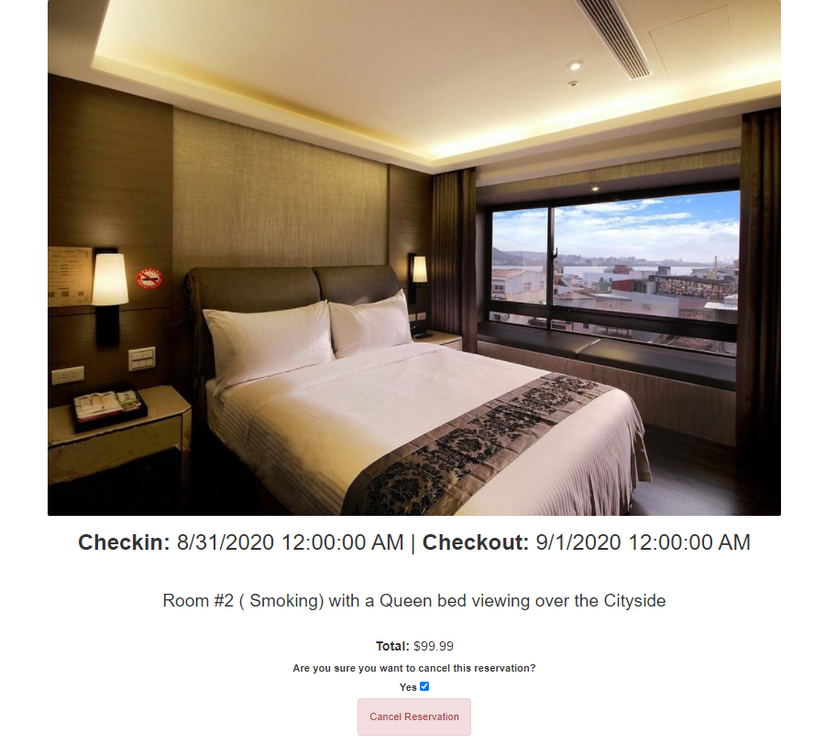
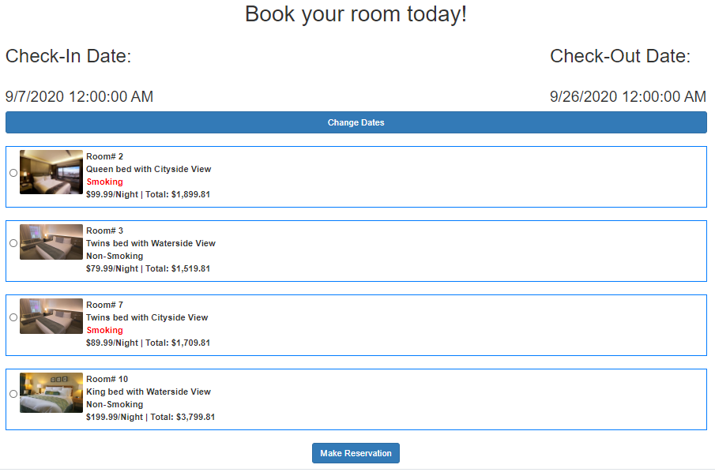
Personal reservation List
People can update their reservation by click Change reservation button.
Room information is showing, and user can cancel the reservation.

Slide 13
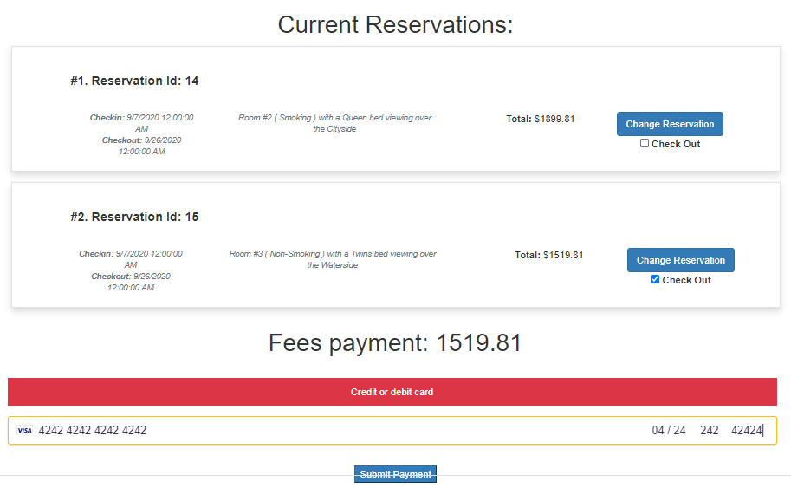
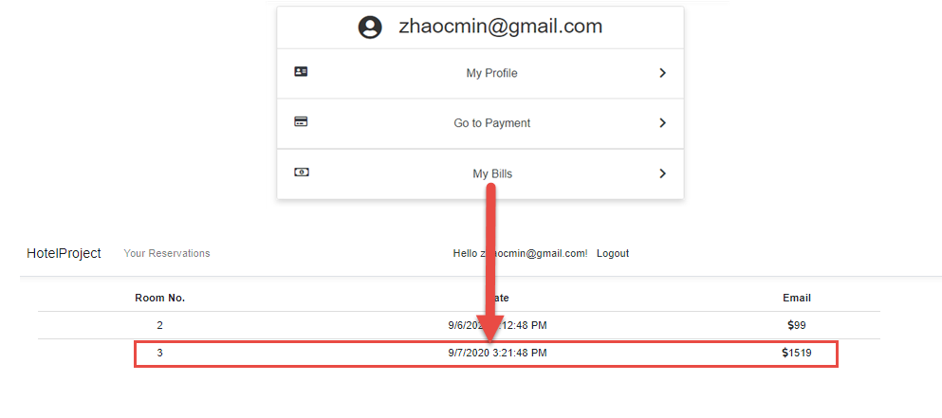
Stripe payment
Stripe Library to create bills by select the check box.

Slide 14
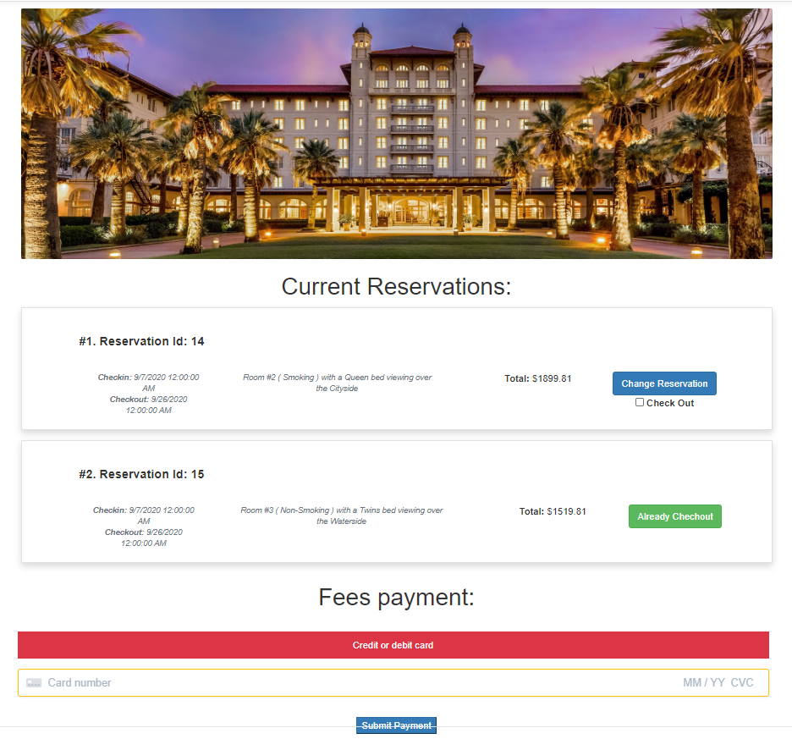
The checked-out item will change the status

Slide 15
Challenges and solutions
Learn how to use the third library is vary challenge.
Stripe, Send blue, Google API.
Retrieving information from the database regarding room occupation

Slide 16
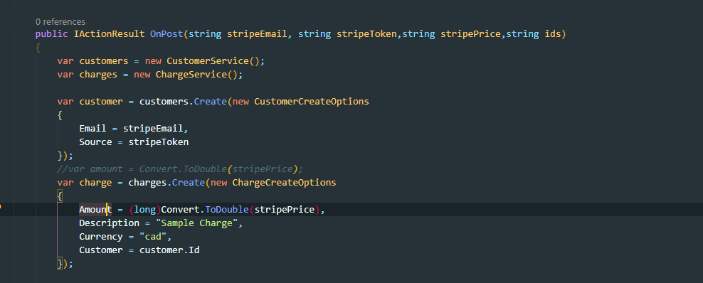
example1, Use stripe Library for
two type payment.

Slide 17
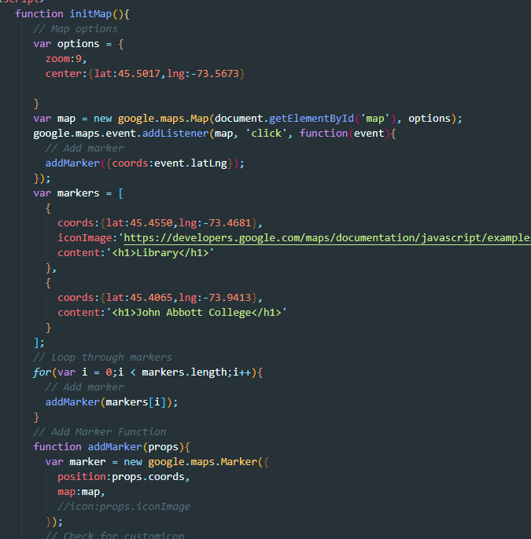
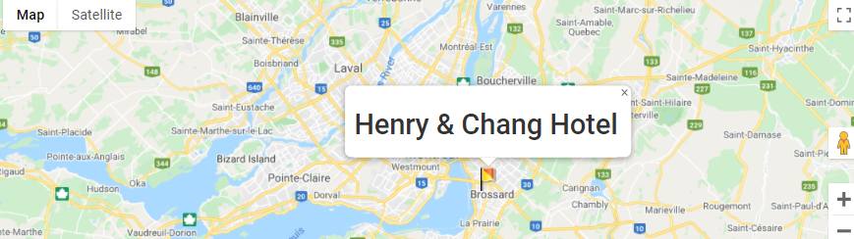
example2, Google Api:
You Should familiar with how to use and read their document and their developer tools. Register for key, secret, get their API.(google Authentication and Map)

Slide 18
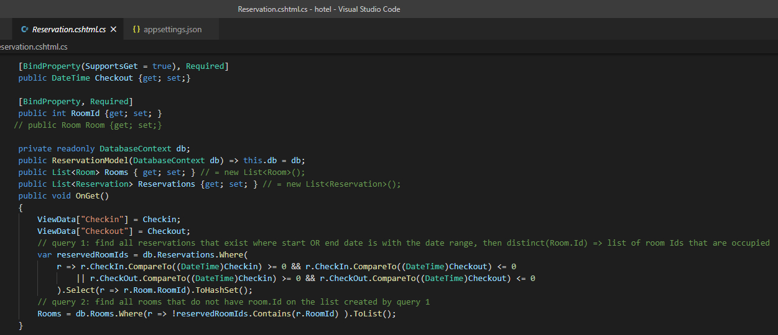
example3, Room Occupation:

Slide 19
Future work
Clear and shrink our code, fully use restful API.
Complete the validation for different functional part.
Hotel activities
inform people by message and email.

Slide 20
Summary
Done:
Login and register.
Forgot password and send email(send blue)
gmail login
validation
Personal page.
My Bills
My Profile
My Payment

Slide 21
Summary
Done:
Reservation system
Room List
Reservation update
Room cancel

